Slide 1

Deepfake Forgery Detection by Dual Model
Shraddha Barge – 23106085
Yash Chalke – 23106027
Moksh Khule – 23106095
Deep Magar – 23106062
Project Guide:
Prof. Shubham Zanwar

Slide 2
Outline
Introduction
Literature Survey of the Existing Systems
Problem Statement
System Design
Implementation
Technologies and Methodologies
Conclusion
References

Slide 3
Introduction
Deepfake technology uses deep learning techniques to create synthetic media, where a person's likeness whether facial features, expressions, or even voice—is convincingly replicated. While such advancements offercreative opportunities in entertainment and education, they also pose serious threats in the form of misinformation, identity theft, and political manipulation. This project aims to build a web application that allows users to upload videos and detect whether they are real or altered using deepfake detection models. The system uses machine learning algorithms to analyze visual patterns in the video and determine its authenticity, making it a valuable tool in digital forensics and media verification.
The DeepFake Detection System supports SDG 9, 16, 4, and 17 by promoting AI-driven innovation, enhancing digital trust, fostering media literacy, and encouraging collaboration for ethical and secure digital systems.

Slide 4
Literature Survey of the Existing System
Title | Conference / Journal Details | Key Points | Improvements Proposed | Citation
Poor Generalization Across Datasets | IEEE/CVPR, 2022–2024 studies on FaceForensics++, DFDC | Models perform well on specific datasets but fail on unseen manipulations | Use multimodal learning and domain adaptation | [1]
Dependence on Single-Modality Features | Springer NLP-CV workshops, 2023 | Systems rely only on visual/textual features, ignoring audio/context | Integrate multimodal cues (audio, temporal, semantic context) | [2]
Computational Complexity and Resource Demands | Elsevier Pattern Recognition, 2022 | Deep models need high-end GPUs, limiting scalability | Develop lightweight architectures, pruning, and knowledge distillation | [3]

Slide 5
Title | Conference / Journal Details | Key Points | Improvements Proposed | Citation
Vulnerability to Adversarial Attacks | NeuraIPS/ACM Security, 2023 | Small perturbations can fool detection models | Incorporate adversarial training and robust optimization | [4]
Lack of Interpretability | IEEE Transactions on Affective Computing, 2022 | Deep models act as black boxes, reducing user trust | Implement explainable AI (XAI) for transparency | [5]
Limited Real-Time Performance | ACM Multimedia, 2023 | High latency prevents real-time/live-stream deployment | Optimize inference with efficient CNN/transformer architectures | [6]

Slide 6
Problem statement
To develop a machine learning-powered web application capable of detecting deepfake videos. The system should be user-friendly, accept video uploads, analyze facial patterns in extracted frames, and output whether the video is authentic or manipulated. It must provide a reliable prediction with confidence and minimize false positives by using a trained model on publicly available datasets.

Slide 7
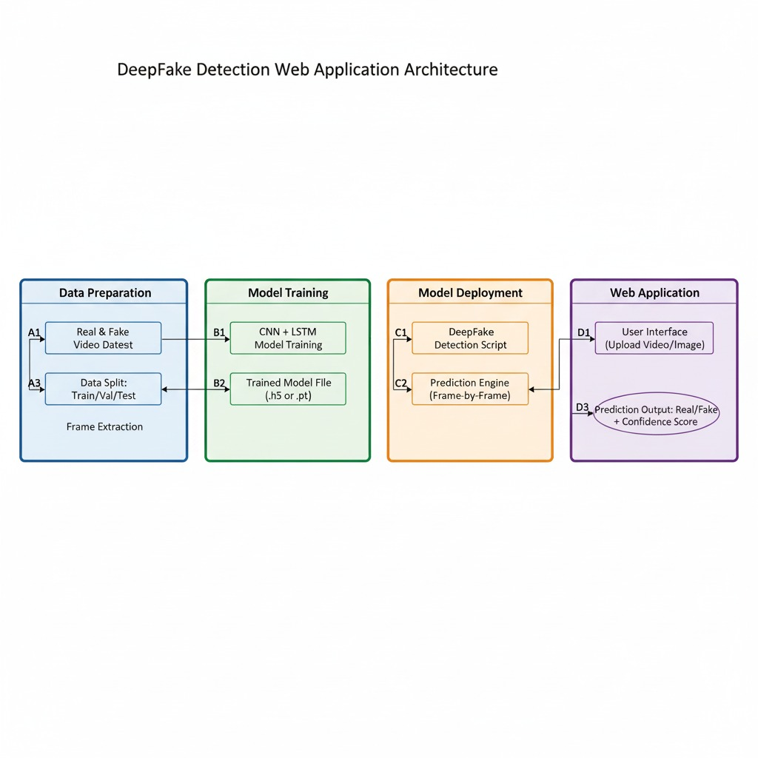
System Architecture & Workflow
This system architecture illustrates a complete end-to-end pipeline for detecting deepfake videos, divided into four main stages

Slide 8
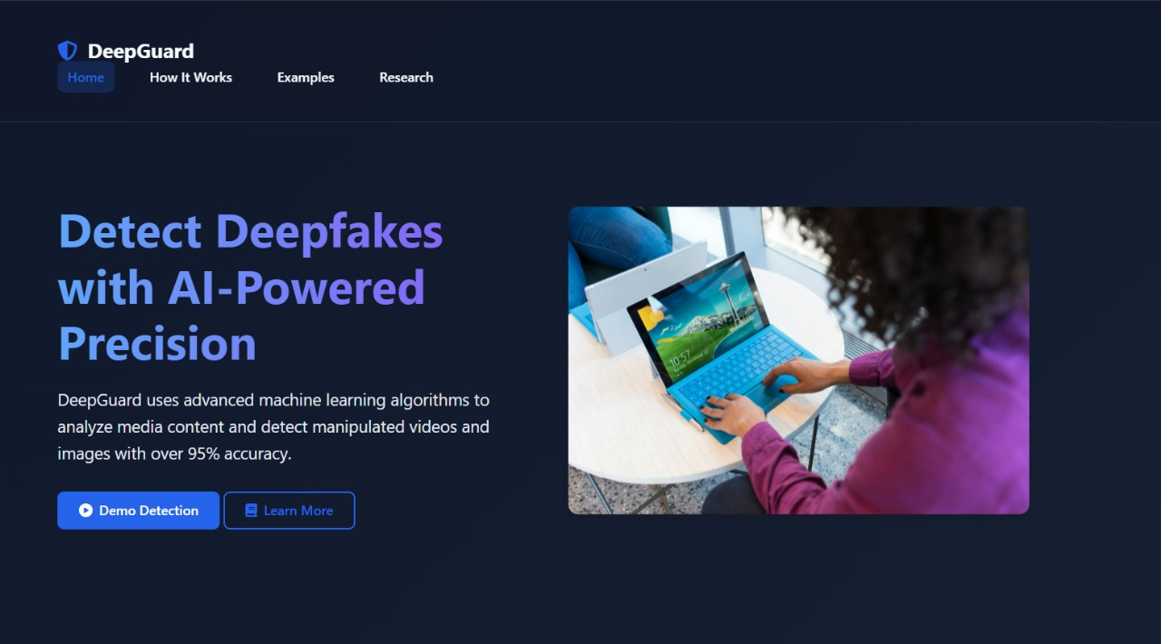
Implementation
Figure 1.Home Page

Slide 9
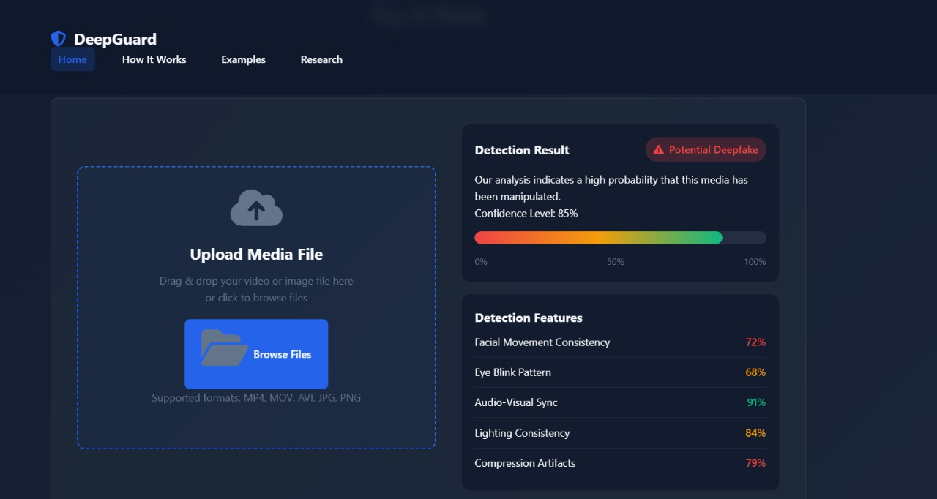
  Figure 2.Uplaod Page

Slide 10
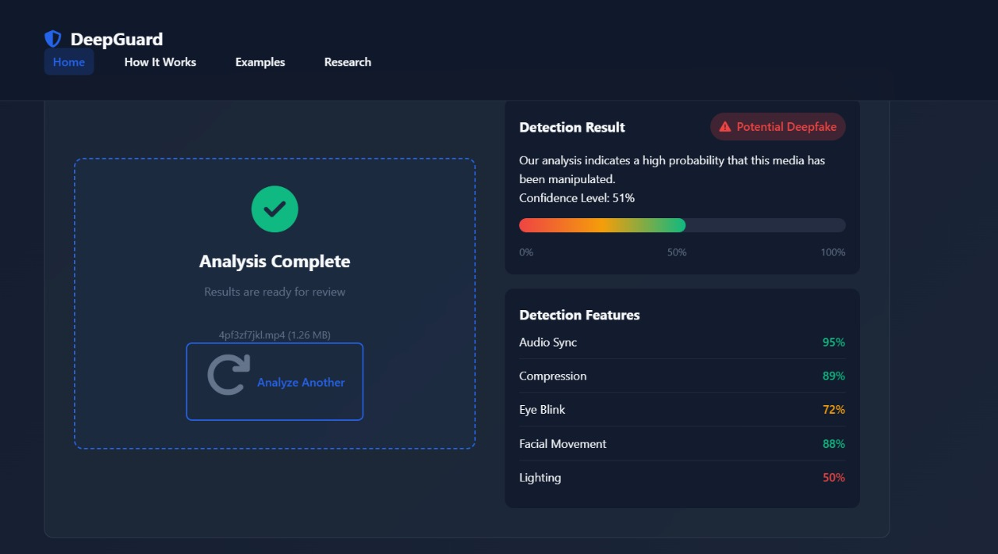
Figure 3.Result Page

Slide 11
Technologies and Methodologies
Frontend Framework:
  HTML, CSS, JavaScript – Used to design and implement the user interface. Provides structure, styling, and interactive elements for uploading videos and displaying results.
Backend:
  Python (Flask) – Handles server-side logic, API endpoints, and communication between the frontend and the deep learning models. Responsible for video preprocessing, frame extraction, and running inference.

Slide 12
Machine Learning / Deep Learning:
  PyTorch – Used for defining, training, and loading the CNN + LSTM deepfake detection model.
  NumPy & Pandas – Support numerical computations, array manipulations, and dataset handling.
  PIL (Python Imaging Library) – For reading, converting, and preprocessing image frames.
  OpenCV – Performs video operations such as reading videos, extracting frames, resizing, normalization, and fallback face detection.
  Mediapipe – Extracts facial landmarks for feature computation, including facial movement and eye-blink analysis.
  scikit-learn – Provides utilities for evaluating model performance metrics such as accuracy, precision, recall, and F1-score.

Slide 13
Conclusion
The project successfully demonstrates a robust deepfake detection system using a CNN + LSTM architecture with EfficientNet-B4 as the feature extractor. By processing video sequences frame by frame and capturing temporal dependencies with LSTM, the model effectively distinguishes between real and manipulated videos. The backend efficiently handles video preprocessing, frame extraction, and inference, while the system incorporates feature-based explanations such as facial movements, eye blinks, and lighting consistency to improve interpretability. Overall, the framework achieves high accuracy, reliability, and practical deployability, making it suitable for real-world applications in social media verification, digital forensics, and combating misinformation.

Slide 14
References
Ianwei Fei, Yunshu Dai, and Peipeng Yu, “Poor Generalization Across Datasets,” IEEE/CVPR, 2022–2024 studies on FaceForensics++, DFDC.
A. Mittal, P. Kumar, D. Mittal, and S. Verma, “Dependence on Single-Modality Features,” Springer NLP-CV Workshops, 2023.
C. Zhang, K. Wang, W. Ouyang, and Q. Wu, “Computational Complexity and Resource Demands,” Elsevier Pattern Recognition, 2022.
Aoxiang Zhang, Yu Ran, Weixuan Tang, and Yuan-Gen Wang, “Vulnerability to Adversarial Attacks,” NeurIPS/ACM Security, 2023.
L. Chen, Z. Wang, W. Deng, and S. Wang, “Lack of Interpretability,” IEEE Transactions on Affective Computing, 2022.
J. Li, H. Liu, Y. Yang, Z. Li, and J. Feng, “Limited Real-Time Performance,” ACM Multimedia, 2023

Slide 15
Thank You...!!

